Slide 1
Markov Chains
When independence cannot be assumed

Slide 2
What are Markov chains?
Future events depend (only) on current state
InDependance

Slide 3
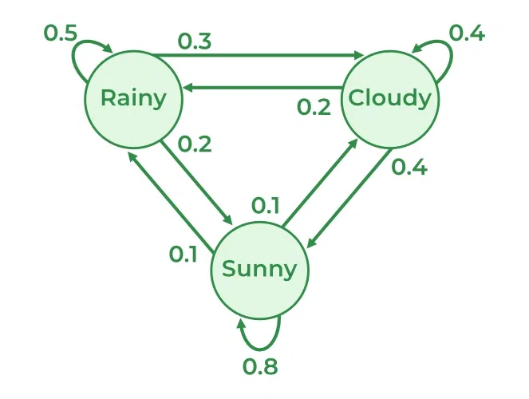
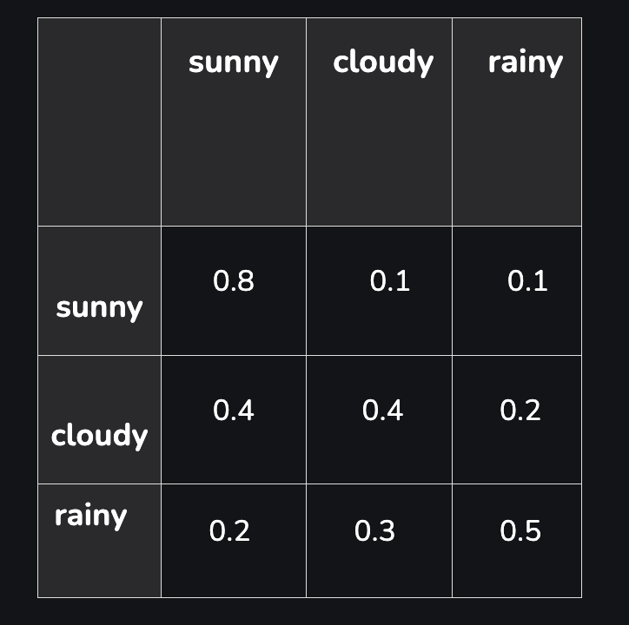
EXAMPLE
Adjacency matrix

Slide 4
What can you do with it?
Statistics
Generative AI and LLMs
Finance

Slide 5
EXAMPLE

